Slide 1
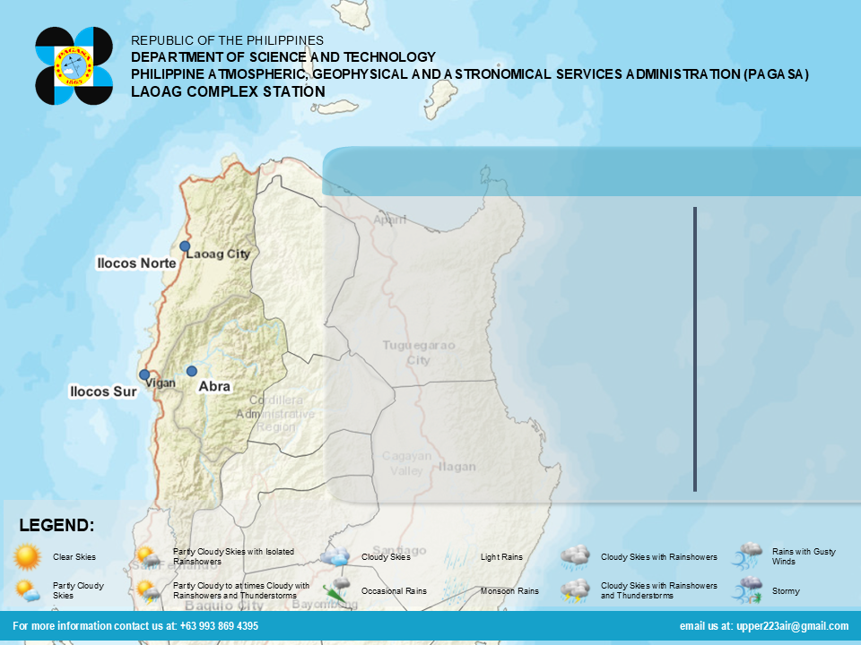





30° C 24 C
Martes - Marso 18, 2025 - 5:00 AM
SASAADEN ITI PANAWEN
Ditoy Ilocos ket maaddaan iti sumagmamano nga ulep, no dadduma naulep a tangatang a pakaibuyogan iti madisso-disso nga apagbiit a panagtudo aglalo iti makin-Amianan ken makin-Daya a passet ti probinsiya maigapo ti Angin Amian. Agpannuray iti napigsa agingga nakapigpigsa a pul-oy iti angin manipod Amianan a Daya.
 | 6:04 AM
 | 6:08 PM
 | Amianan a Daya
 | 2.8 – 24.5 m
31° C 18° C
31° C 23° C
SITWASYON ITI BAYBAY
Ti baybay ket nadawel agingga nakadawdawel. Adda naibayug a Gale Warning kadagiti baybay a sakupen ti Ilocos Norte ken Ilocos Sur (sinait, Cabugao, San Juan, Magsingal).Mabalin nga umabot ti katayag ti dalluyong manipod 2.8 agingga ti 4.5 a metros.Maballa-agan dagiti mangngalap a maiparit ti tumapog iti baybay. Kasta met kadagiti dadakkel a barko a mapan da agan-annad iti dadakkel a dalluyong.

Slide 2






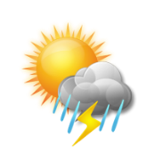





TO CHANGE THE ICON:
Select the image
Click “FORMAT” then select “CHANGE PICTURE”
Click “From a file / (Browse)”
DAY ICON ADDRESS:
C:\Users\Server-Comp\Desktop\LOCAL FORECAST\LOCAL FORECAST PRODUCT EDITOR\Weather Icons\Day Icons
SELECT the corresponding ICON
 | Clear Skies |  | Light Rains
 | Partly Cloudy Skies |  | Monsoon Rains
 | Partly Cloudy Skies with Isolated Rainshowers |  | Cloudy Skies with Rainshowers
 | Partly Cloudy to at times Cloudy with Rainshowers and Thunderstorms |  | Cloudy Skies with Rainshowers and Thunderstorms
 | Cloudy Skies |  | Rains with Gusty Winds
 | Occasional Rains |  | Stormy

